Slide 1

Defense & Isolation Against Digital Adversaries
Chinmay Pandey - 2019-B-20092001A
Prasad Suman Mohan - 2019-B-15112001A
Ashutosh Mahajan - 2019-B-26042002
Prof. Sukesh Kothari

Slide 2
Contents
Introduction
Literature Review
Objectives
Methodology
Hardware and Software requirements
Discussion and Scope of Usage
Future Scope
References

Slide 3
Introduction and Problem Statement
Cyberattacks are an all time high and they continue to rise in quantity and severity with several magnitudes on a Year-on-Year basis.
The technologies that exist to defend against such attacks need time to develop and update against new attack techniques. Hence, attackers are almost always a step ahead from defense teams.
Honeypots are one such deployable solutions that can lure attacker but it depends upon the idea that an attacker gets lured into it at first place.
This project aims to eliminate this shortcoming by tightly coupling several components, along with a “honeypot like environment” that is the replica of existing system but serves as a dummy host that can isolate attacker from other connections.

Slide 4
Introduction and Problem Statement
The raw idea behind this project primarily deals with time with respect to both the digital adversary and the defense teams trying to keep the target secure. Once an attacker breaches an infrastructure, they have to quickly perform their tasks, with utmost covertness within a short amount of time.
Similarly, when a breach occurs, the SOC and incident response teams must take quick actions to find and identify source of breach and any persistent threat.
The project will help defense teams buy more time to analyse situation, make a judgement and take action on it.
At the same time, for an attacker, the time will be cut short significantly because the system will also alert the entire defense about the attacker.

Slide 5
Literature Review
Hiding things from hackers is common practice in computer security [1]. The art of deception can go a long way if played out well. We can deceive the attacker in another way if we trick them into believing that they can get access to a target system after sometime.
Creating a diversion that looks like a legitimate application is one such way. A diversion that leads attackers away from any action that would cause severe damage to actual systems [2].
A honeypot is one such diversion but it has its own limitations. A honeypot serves as a vulnerable environment that alerts security teams if someone accesses the honeypot [3]. The primary limitation is that, it is upto the adversary to not even touch the honeypot actively if they happen to find one.
If an adversary wishes to find more data for exfiltration or credentials hardcoded into the system for privilege escalation then they usually do this in lateral movement stage of attack and AWS tries to mitigate such attack by means of Canary tokens [4].

Slide 6

Objectives
Create confusion for the adversary in lateral movement.
Aid SOC team and Incident respondent to buy sufficient time and preliminary analysis and determine severity of the attack.
Partially act as honeypot environment to contain adversary for as long as possible.
Act as an easy-to-acquire bait for enemy.

Slide 7
Methodology
Defense system:
It is basically a smart reverse proxy that analyses incoming traffic and determines whether this should go inside legitimate host or sandbox / smart-honeypot environment.
It is modular and can be used in a lot of places, right before the position at which the application is deployed
Along with a reverse proxy, we use a one - on - one copy of hosted application or software that acts as a vulnerable honeypot in order to lure adversary.
Both reverse proxy and sandbox environment are critical components as reverse proxy determines where should the data be sent and sandbox environment keeps the adversary busy for incident response teams
The diagram in upcoming slides represent High Level overview of common systems and our proposed solution.

Slide 8
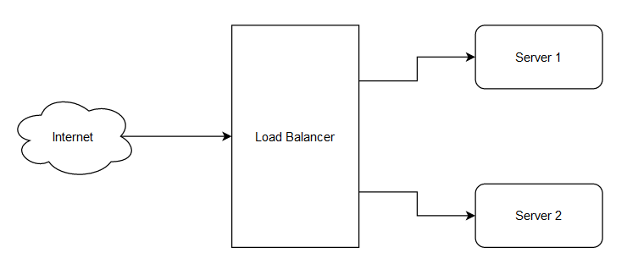
Methodology
High level diagram of existing systems:

Slide 9
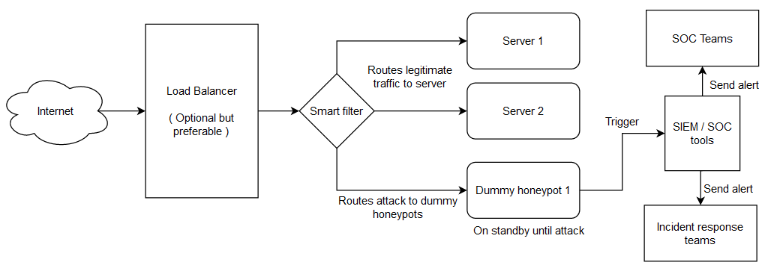
Methodology
High level diagram of proposed solution:

Slide 10
Methodology
Simulation to test the entire program
We use type-2 virtualization to host the entire infrastructure in local machine.
Docker instances will act as DNS servers and everything including name servers, dns servers will be virtualized.
One application will be hosted on a virtualized instance that acts as our legitimate host application and another honeypot instance will have same but less functional software full of fake data and vulnerabilities to lure attacker into thinking they got the access.
Once the attacker's request reaches filter/reverse proxy, the filter will determine if it is a cyber attack that needs to be routed in honeypot or a legitimate request that goes to actual application.
The entire process can run inside a type - 2 virtualized environment hosted on either Linux or windows environment running on x86_64 architecture. Since there will be a lot of virtualized components involved, it is recommended to at least have 16GB of RAM and 3 GB of free disk space available within the system for optimal performance.

Slide 11
Hardware and Software Requirements
Hardware :
An x86_64 architecture based computer with at least 4 core (Physical or Logical) CPU.
16GiB of primary Memory.
3GiB of free disk space.
Hardware virtualization enabled in BIOS.
Software :
Windows or Linux operating system.
Type 2 virtualization software such as VirtualBox.
Docker

Slide 12
Discussion and Scope of Current Usage
Although it was successful in keeping the attack away from actual application, the major issue with this setup is latency
Active real time analysis of incoming data is process intensive task and takes time to analyze everything , and then make a decision on routing the data. Hence this system should not be used in series with a latency sensitive application such as stock market servers, esports etc.
The overhead of maintaining a standby replica of existing environment add up in cost to existing organization and may not be feasible for small and medium scale enterprises. It will be a very crucial protection software for Large enterprises as of now.
The program, in all its functionality, aims to serve as an alert system, a honeypot/sandboxed environment, and something that helps early incident responders buy time for analysis and decision making as well as reducing the time an attacker can stay within the network without being detected.
If the organization has any counter-offense service or team then they can analyse the adversary and launch their own attack against them.

Slide 13

Future Scope
Convert existing product into a fast product capable of doing real time analysis with least possible latency overhead.
Implementation of real time malware analysis in case a client tries to upload file to an application, which supports accepting files, and the file contains malware. This component will be added both in legitimate application as well as sandboxed environment to quickly get results of malware analysis.

Slide 14
References
[1] : https://www.researchgate.net/publication/228821623_Using_deception_to_hide_things_from_hackers_Processes_principles_and_techniques
[2] : https://inldigitallibrary.inl.gov/sites/sti/sti/4247207.pdf
[3] : https://www.techtarget.com/searchsecurity/definition/honey-pot
[4] : https://blog.thinkst.com/2022/02/a-safety-net-for-aws-canarytokens.html
[5] : https://blog.verisign.com/security/defending-against-layer-7-ddos-attacks/
[6] : https://www.indiamart.com/proddetail/future-scope-graduate-aptitude-test-9732778362.html

